Slide 1



High Resolution Regional Mapping of Crustal Magnetic Fields on Mars
Cody Fischer
Mentor: Dr. Lon Hood
University of Arizona
AZSGC - April 18th, 2026

Slide 2
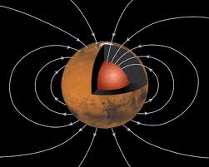
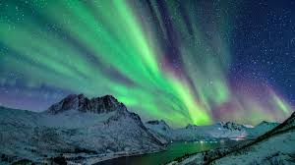
Background:
What are crustal magnetic fields?
Fields produced by magnetized rock formations below the Martian surface.
Magnetized by the ancient planetary dynamo—the process in which a molten metallic core rotates and convects to convert kinetic energy into magnetic energy.
Why is this important?
A global magnetic field acts a shield from solar wind protons, protecting the planet’s atmosphere from being stripped away, potentially allowing a warmer, wetter climate.
Crustal magnetic field mapping helps pin-point when the Martial dynamo ceased.
NASA/JPL 1997
McGough 2025

Slide 3
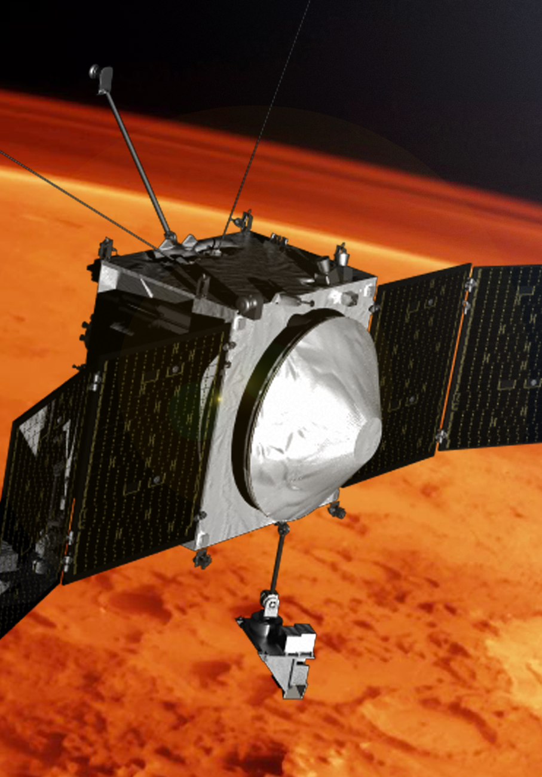
Methodology:
Data acquisition:
Data was measured using a magnetometer on board NASA’s Mars Atmosphere and Volatile EvolutioN (MAVEN) spacecraft.
Data Selection:
Only orbit passes with periapsis altitudes of <170 km are considered.
In a 40° by 40° region this criteria selects only several hundred orbit passes.
NASA 2017

Slide 4
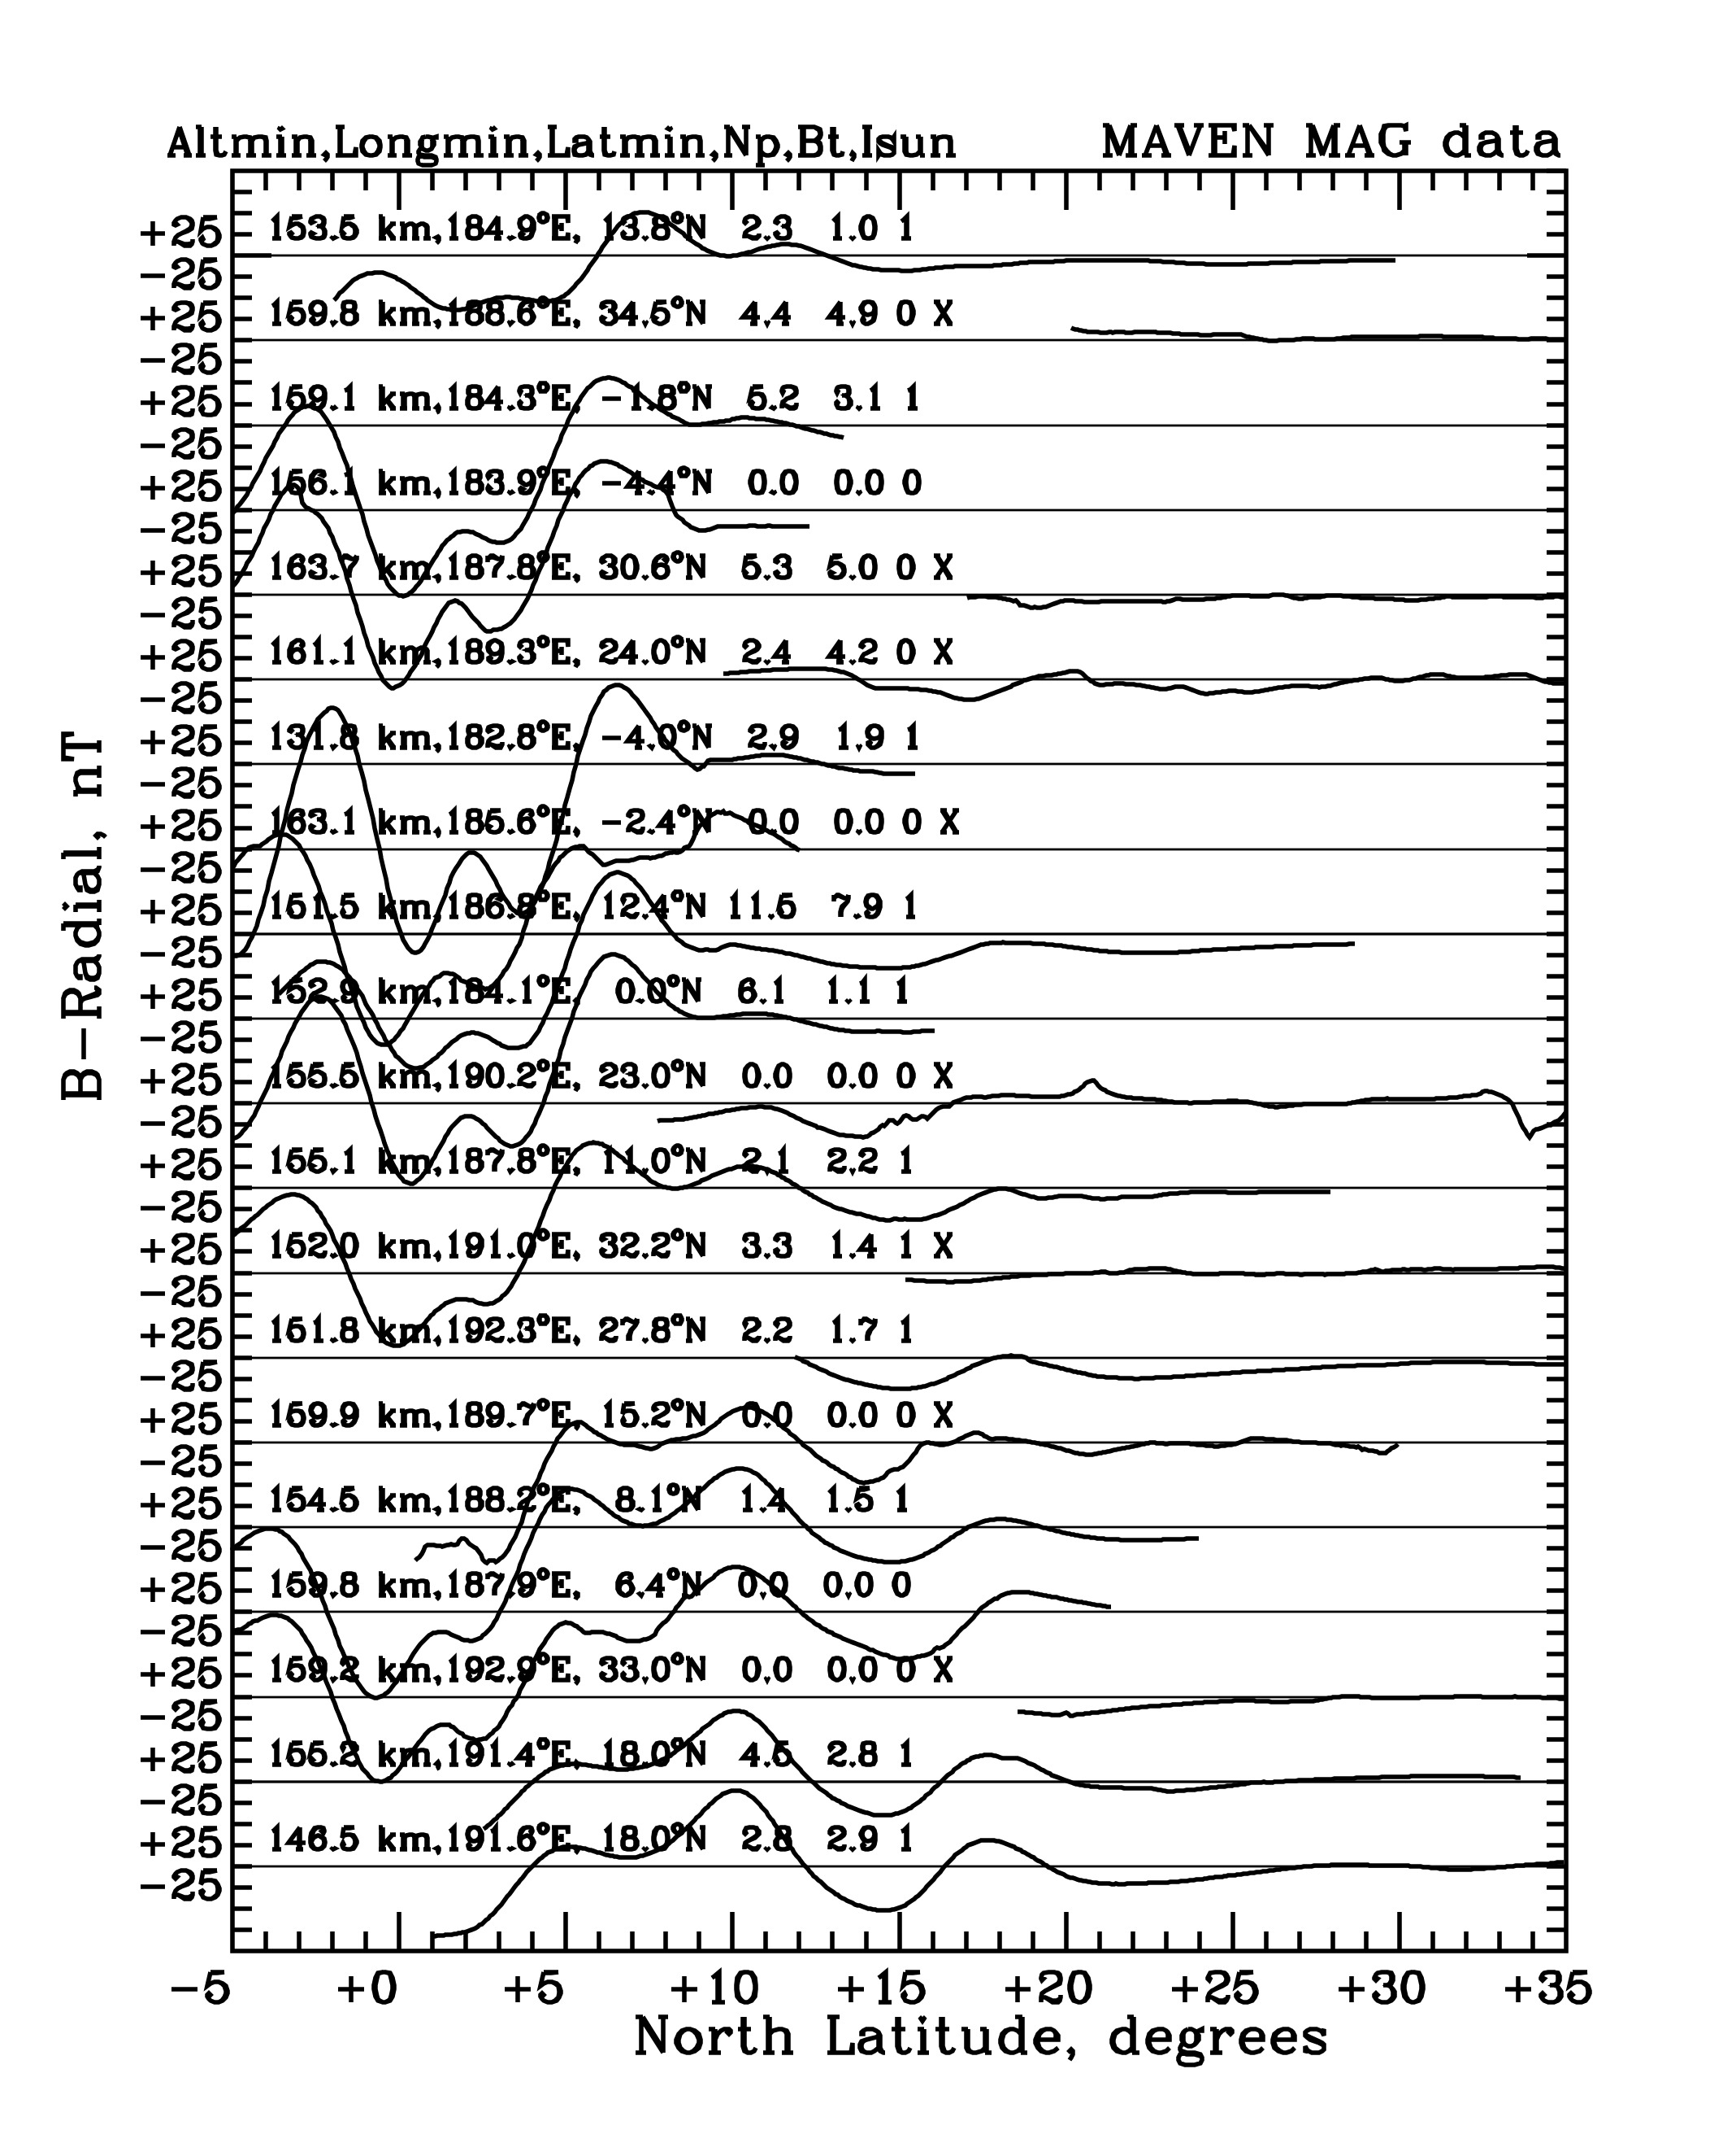
Methodology:
Data analysis:
  Final decisions are based on repetition or lack thereof of magnetic anomalies seen from “stack plot” visuals.
  This allows for the removal of undesirable orbit passes.
  An “X” indicates a “bad” orbit pass.
  Sufficient data coverage in a given region is also important.

Slide 5
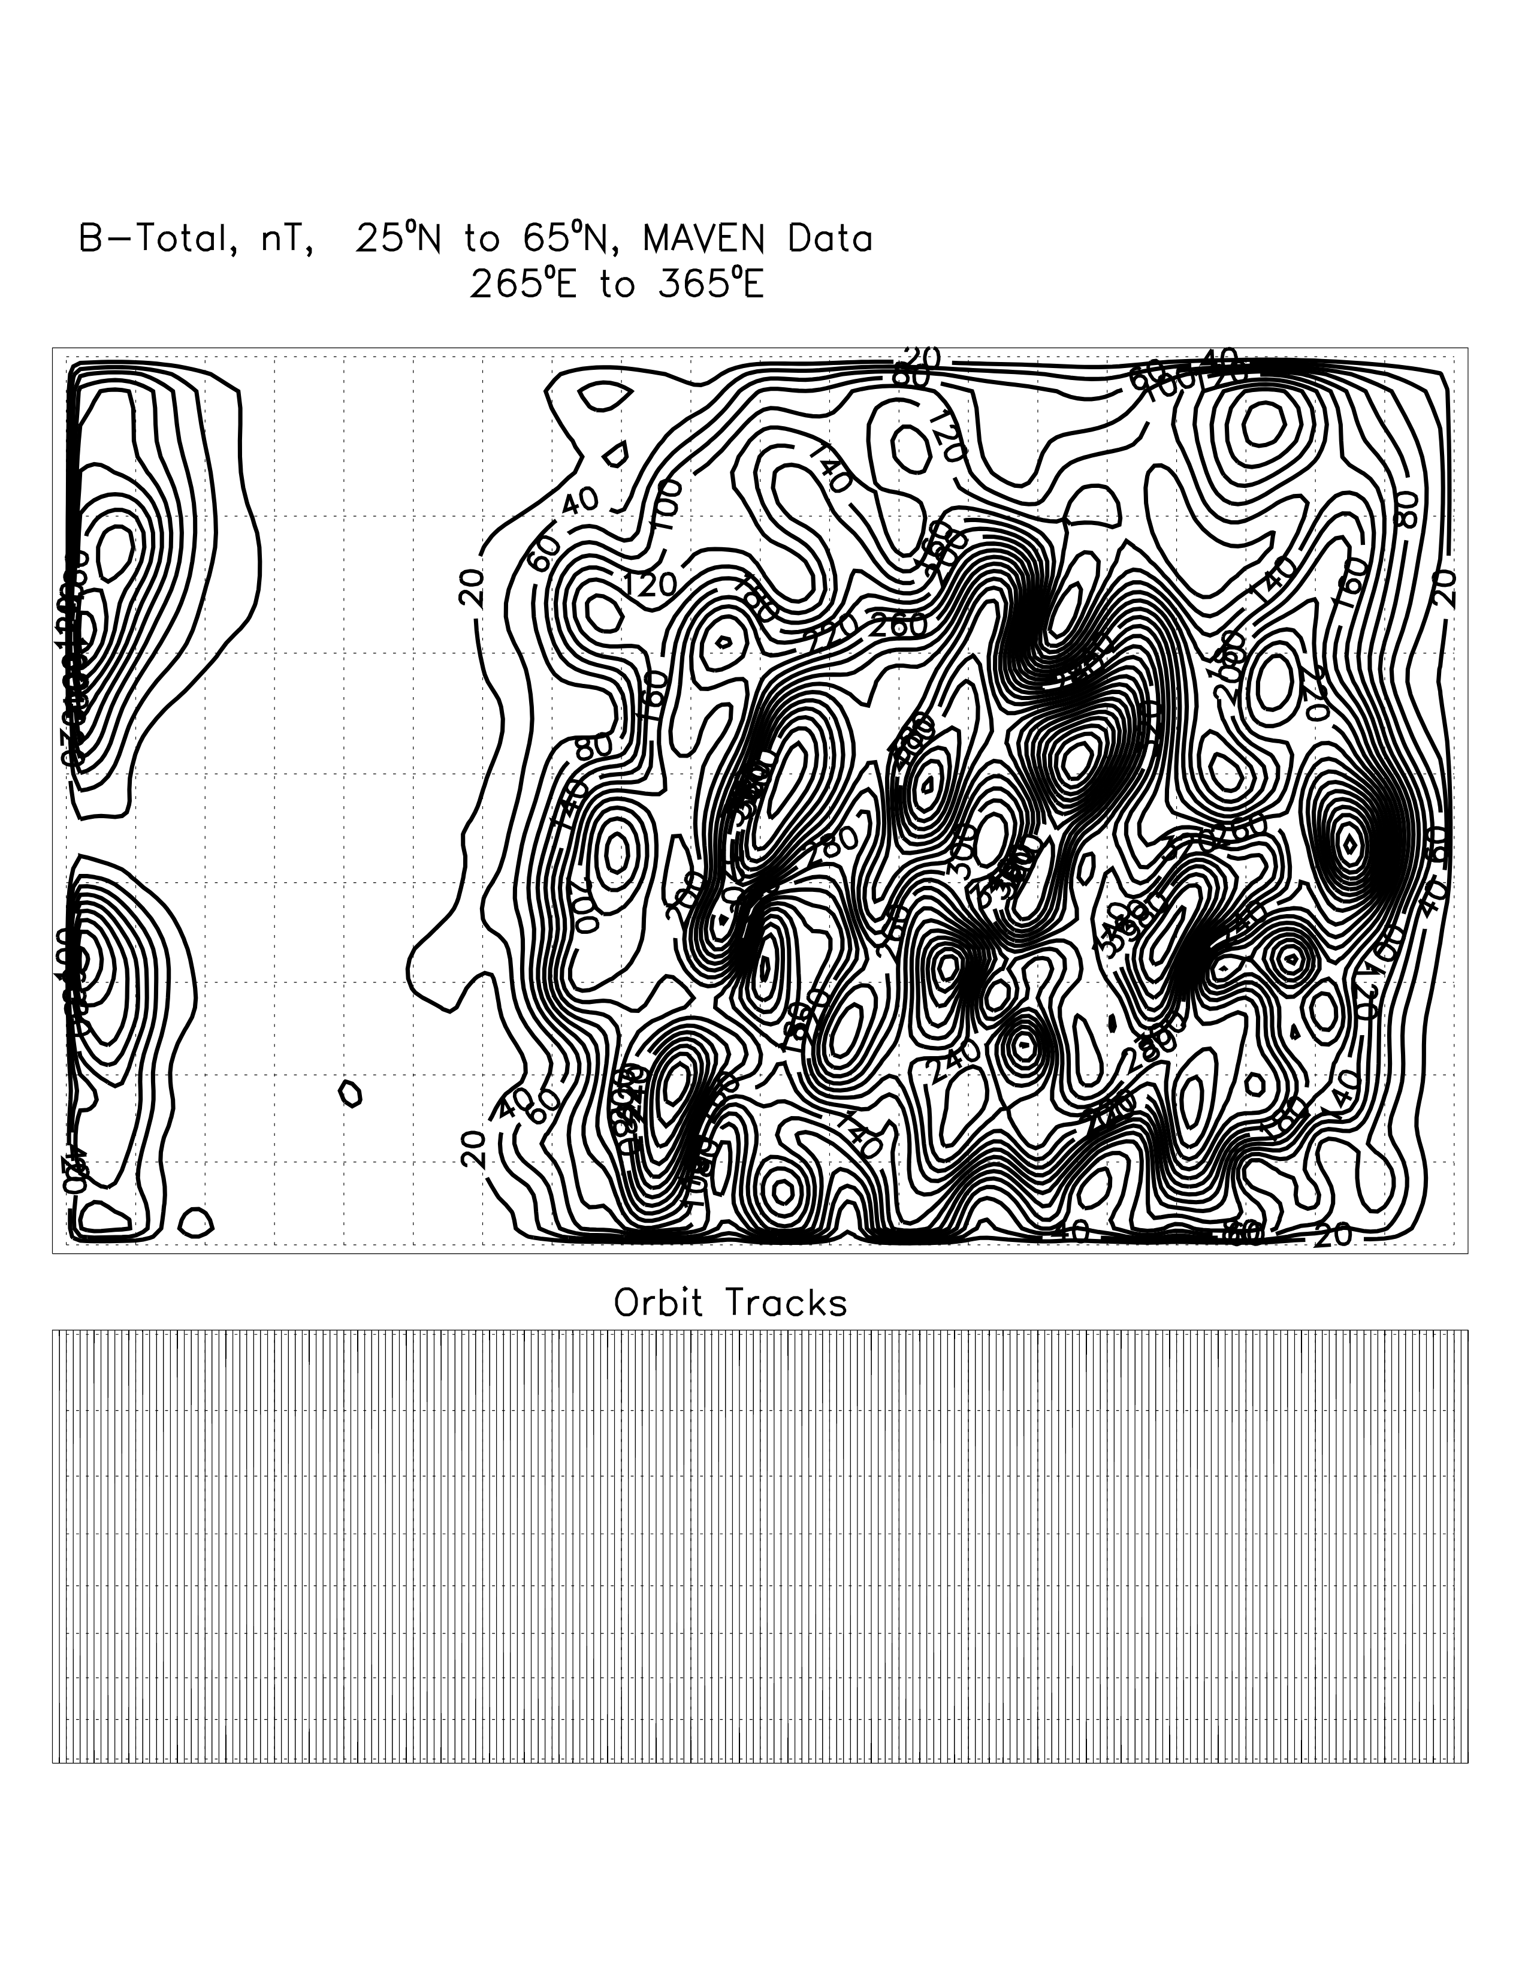
Methodology:
Mapping:
  High-resolution regional maps are created by employing the equivalent source dipole (ESD) method.
  Employs mathematically modeled dipole moments to represent the magnetic field strength.
  High quality data selection is key.
  Magnetic fields are displayed as contour maps.

Slide 6
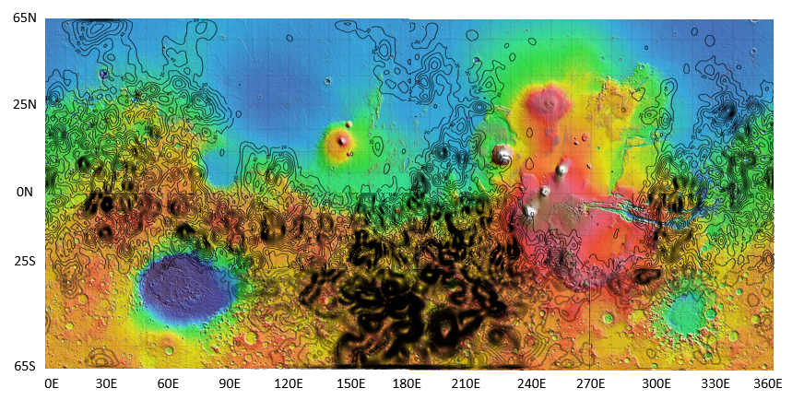
Results:
Mapping:
  All 16 regional maps (65S-65N) were superimposed onto a color map of Mars topography produced by the Mars Orbiter Laser Altimeter.
Olympus Mons
Hellas
Claritas Fossae

Slide 7
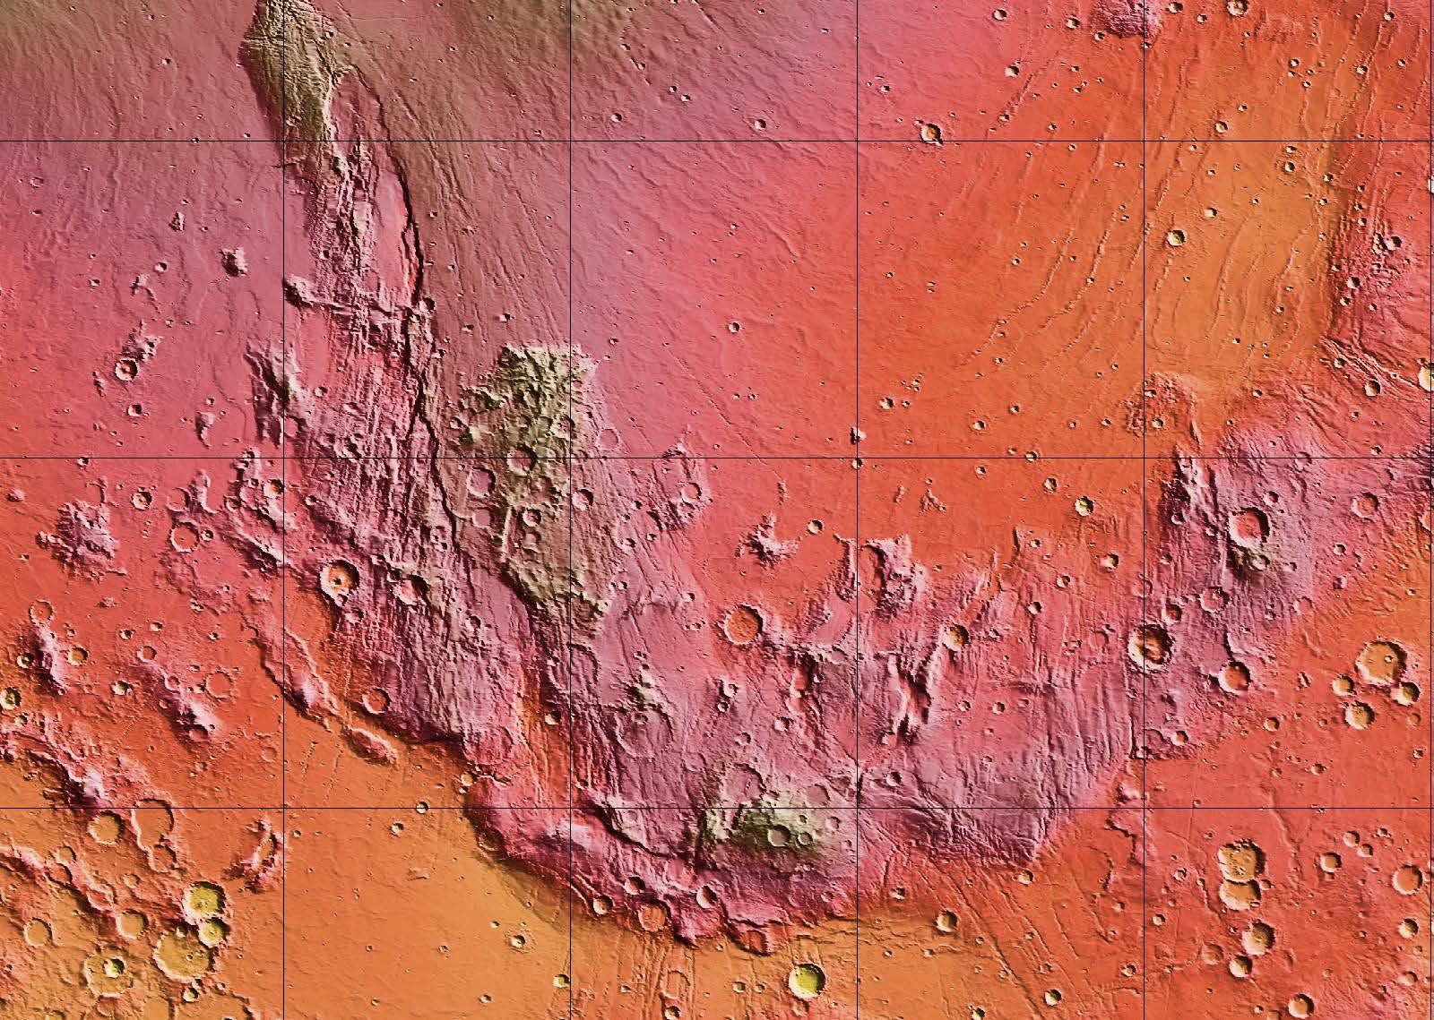
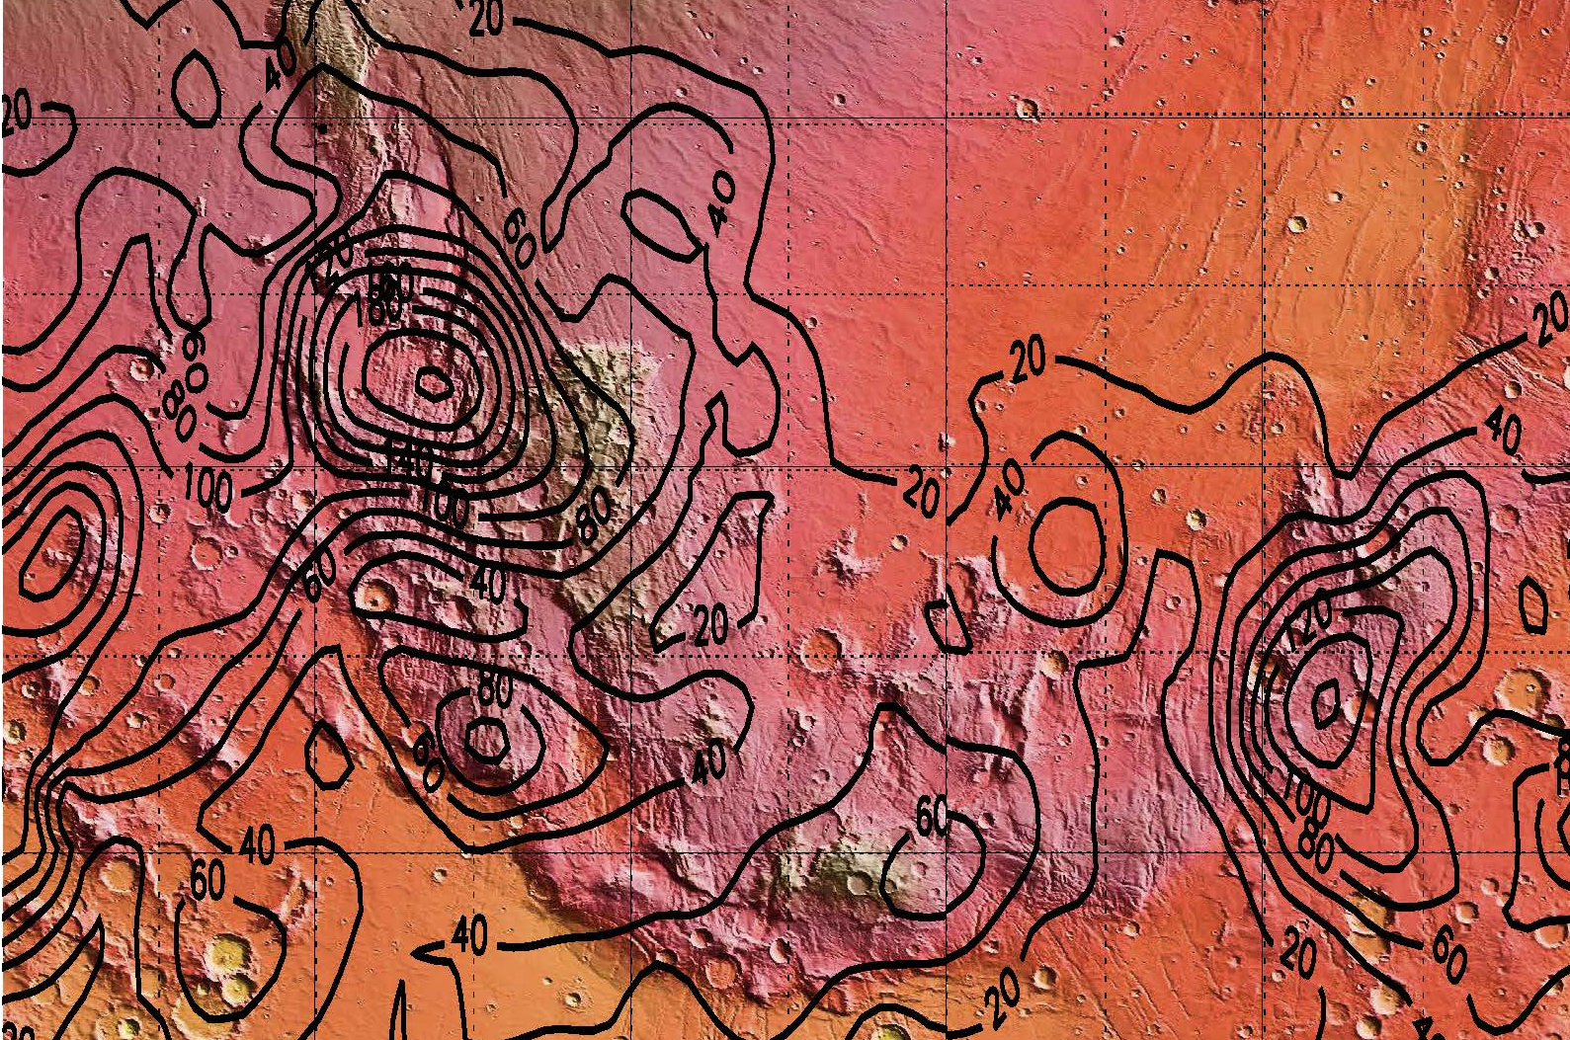
Results:
Geological Comparison:
  These maps can be used to better determine the history and duration of the Martian dynamo by comparing magnetic anomalies with volcanic and geological features that have been assigned “ages” by Mars geologists.
  The Claritas region is of high interest.
  In the future, other regions can be compared to pin-point the dynamo duration.
Claritas Region
Claritas Region

Slide 8
Thank You!
(Special Thanks to the U of A Space grant and my mentor Dr. Lon Hood)

